Slide 1
Recommending the best neighbourhoods for opening a coffee shop in Toronto City.

Slide 2
Contents .
Introduction.
Business Problem.
Data.
Sources of Data.
Methodology.
Results.
Conclusion.

Slide 3
Introduction
Generally most of the people like to spend time with friends by hanging out at place, and few people like to meet new people to discuss their business ideas and some informal meetings. The ideal place for this type of gatherings will be a coffee shop.

Slide 4
Business Problem
If a person is looking to open a new coffee shop in Toronto, where will you recommend him to open a coffee shop?

Slide 5
Data
List of neighbourhoods in the city of Toronto.
Latitude and Longitude of those neighbourhoods in order to plot the map of those neighbourhoods and also to explore the venues.
Venue data mainly pertaining to coffee shops is required to perform the clustering on neighbourhoods.

Slide 6
Sources of Data
Will scrape the required data from the Wikipedia page using required python libraries.
Then we will use Foursquare API which has one of the largest database of places.
From Foursquare API we will explore the neighbourhoods.

Slide 7
Methodology
Scrape the required data from Wikipedia page and making a data frame by merging the Geospatial coordinates of the neighbourhoods.
By making API calls we will get the required venue details.
Will filter out the coffee shops category from the data for performing clustering
We use K-MeansClustering for segmenting the neighbourhoods into 5 clusters.

Slide 8
Results
Cluster 0: Neighbourhoods with moderate number of coffee Shops.
Cluster 1,2,3,4: Neighbourhoods with no existence of Coffee Shops.

Slide 9
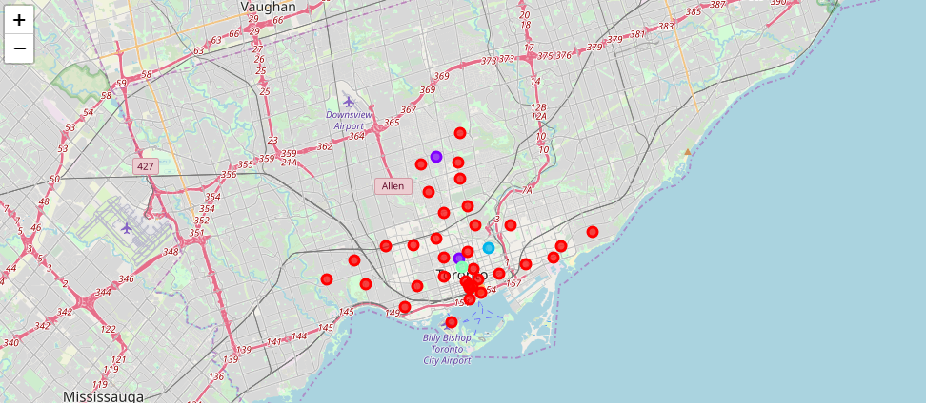
Fig: Visualizing of clusters.

Slide 10
Conclusion
Most of the coffee shops are concentrated in Downtown area of Toronto, with moderate number in cluster0 and there are no coffee shops in clusters 1, 2, 3, 4.
To answer the business question that was raised, the project proposes the following answer: The neighbourhoods in cluster 1,2,3,4 are the most preferred locations to open a new coffee shop.
The entrepreneurs are not advised not to start in cluster0 as it has moderate concentration of coffee shops and the competition will be there from the existing shops.
If they want they can start in cluster0 with some innovative ideas and they should be up for challenges in facing the competition

Slide 11
THANK YOU

